Slide 1
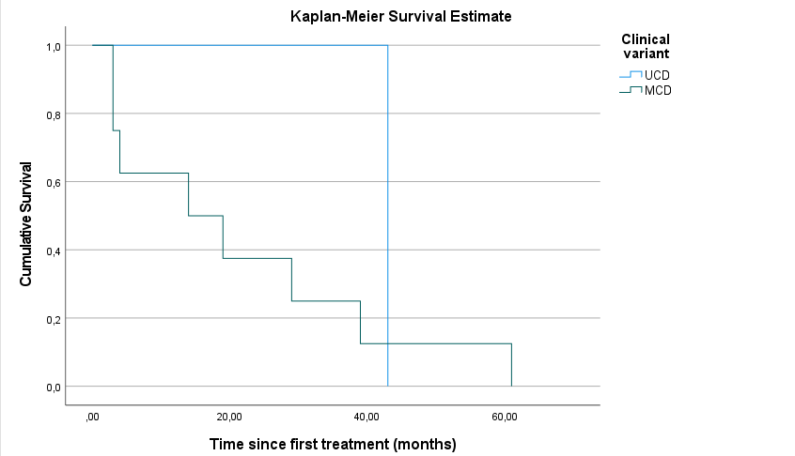
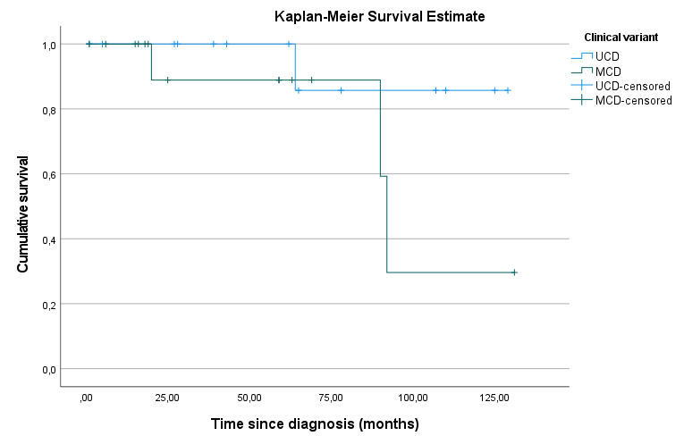
CASTLEMAN DISEASE: A BRAZILIAN MULTICENTRIC COHORT OF A RARE HEMATOLOGICAL DISORDER
Brandão AAGS ^{1,2,3}, Melo RCB ^{1,2}, Bellesso M ^{1,2,4}, Aranha MAF ⁴ , Fernandes HS ³ , Farias DLC ³ , Scheinberg P ³ , Pereira J ^{1,2}, Rego EM ^{1,2}, Rocha V ^{1,2}
¹Division of Hematology, Transfusion Medicine and Cell Therapy, Hospital das Clínicas da Faculdade de Medicina da Universidade de São Paulo, São Paulo, SP, Brazil ² Instituto do Câncer do Estado de São Paulo, Hospital das Clínicas da Faculdade de Medicina da Universidade de São Paulo, São Paulo, SP, Brazil ³Hospital A Beneficência Portuguesa de São Paulo, São Paulo, SP, Brazil ⁴ Instituto Hemomed de Ensino e Pesquisa, São Paulo, SP, Brazil
INTRODUCTION
Table 2. First line therapies employed in MCD patients
POEMS associated MCD (n=3) Rituximab monotherapy Cyclophosphamide monotherapy Steroids alone | 1 (33.3%) 1 (33.3%) 1 (33.3%)
HHV-8 positive MCD (n=3) Rituximab plus liposomal doxorubicin Steroids alone | 2 (66.6%) 1 (33.3%)
Idiopathic MCD without TAFRO syndrome (n=9) Steroids alone Rituximab monotherapy Thalidomide, cyclophosphamide and prednisone Active surveillance | 5 (55.5%) 1 (11.1%) 1 (11.1%) 2 (22.2%)
Castleman disease (CD) is a rare and sometimes difficult to diagnose hematological condition, with a pathophysiology not fully understood and a wide clinical spectrum. Unicentric CD (UCD) patients have an excellent prognosis contrasting with the multicentric presentation, which may be life-threatening. Data of CD in Brazilian patients’ is still limited.
METHODS
We retrospectively collected data of patients with biopsy-proven CD in three large Brazilian centers (Hospital das Clínicas da Faculdade de Medicina da USP, Hospital A Beneficência Portuguesa de São Paulo and Instituto Hemomed) from January 2008 to July 2020.
RESULTS
Median progression free survival (PFS) was 43 months for UCD and 14 months for MCD patients. Median overall survival (OS) for UCD patients was not reached and was 92 months for MCD patients. At 2 years, PFS for UCD patients was 100% and 37.5% for MCD patients. Three MCD patients died of CD progression and one UCD patient died after 6 years of follow-up (death unrelated to CD).
Twenty-nine patients with confirmed CD were included. Table 1 summarizes baseline characteristics of CD patients. Median follow-up duration was 59 months.
Table 1. Baseline characteristics of CD patients
Median age (years) at diagnosis (range) | 46.1 (19.1-87.9)
Male | 17 (58.9%)
Median time to diagnosis after onset of symptoms | 18.5 months
Clinical variant Unicentric CD Multicentric CD (MCD) - POEMS associated MCD - HHV-8 positive MCD - idiopathic MCD without TAFRO syndrome | 14 (48.3%) 15 (51.7%) 3 (20%) 3 (20%) 9 (60%)
All UCD patients had lymph node disease and nodal areas involved were cervical (35.7%), thoracic (28.6%) and abdominopelvic (35.7%). MCD patients’ symptoms at diagnosis more commonly were multicentric lymphadenopathy (93.3%), weight loss (40%), fever (40%) and night sweats (33.3%).
First line therapies employed in MCD patients are described in table 2. All UCD patients underwent surgery and one UCD patient had a localized relapse requiring another surgery. Eight MCD patients needed additional treatment due to progressive disease, with a median time to next treatment of 16.5 months. Siltuximab was administered in 22.2% patients with iMCD during disease course. Other therapies delivered for iMCD patients were chemotherapy with CHOP or CHOP-like protocols in 6 patients, radiotherapy and tocilizumab each one in one patient.
Figure 1a: Progression-Free Survival after first line therapy Figure 1b: Overall Survival
DISCUSSION AND CONCLUSION
This is the largest Brazilian cohort of CD patients reported to date, to our knowledge. As described by other groups, our outcomes of UCD patients are better than MCD patients. Therapies for MCD were heterogeneous due to lack of a specific treatment until recently. However, most MCD patients still do not have access to recommended first-line therapies, in particular in public healthcare, with a negative impact in their outcomes. The development of a national registry of CD patients in Brazil may raise awareness to this rare entity.

